Slide 1


Introduction to Agile Project Management Techniques
PRESENTED BY: Justin Ramsdill

Slide 2
Outline
What is project management?
Definition of project management
Waterfall vs. agile
Philosophy of Agile
Agile Overview
Scrum Overview
Artifacts
User story
Scrum workflow
Project lifecycle Overview in relation to a research study
Project Definition/Grant Writing
Planning
Execution
Closure
Security
Tools

Slide 3

What is Project Management?
The application of knowledge, skills, tools, and techniques to project activities to meet the project requirements. –PMI.org_{[1]}
Use knowledge and best practices to systematically manage the process of running a project.
3

Slide 4

PDLC: Project Development Lifecycle
Notes:
It is a process that describes how to develop, design and maintain the software project ensuring that all the functional & user requirement, goals and objective are met. This methodology improves the quality of the software project and over all process of software development. The standardized methods and processes to complete a project.

Slide 5

Project Management Methodologies
Waterfall
Kanban
Scrum
XP
Six Sigma / Lean
5

Slide 6
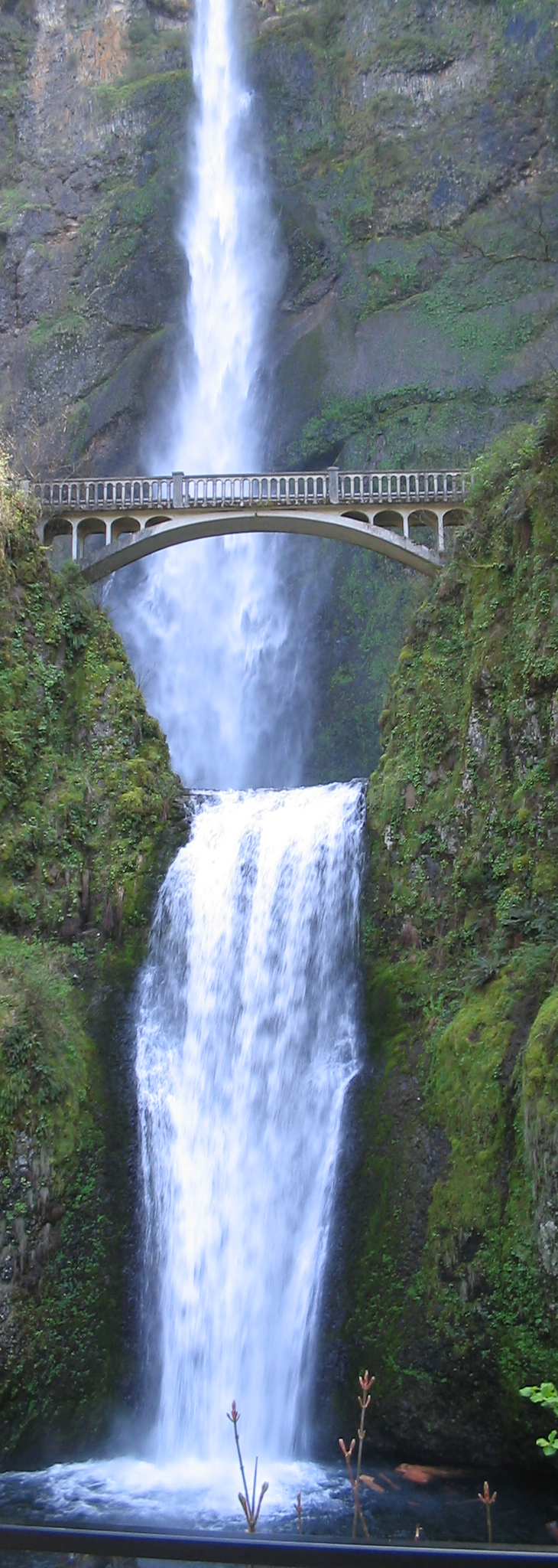
Waterfall
In a waterfall model, each phase must be completed fully before the next phase can begin. This type of software development model is basically used for the for the project which is small and there are no uncertain requirements.
At the end of each phase, a review takes place to determine if the project is on the right path and whether or not to continue or discard the project.
In this model software testing starts only after the development is complete.
In waterfall model phases do not overlap.
6

Slide 7
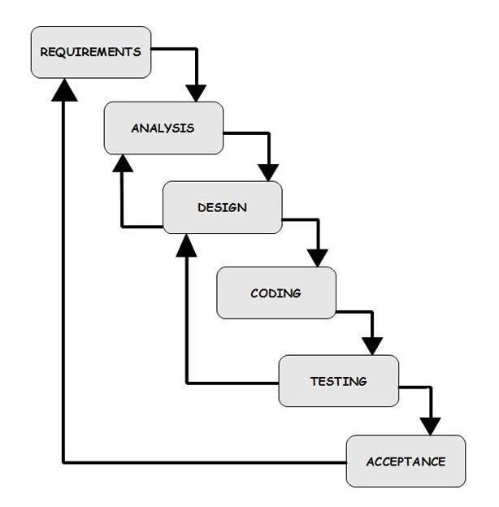
Diagram of Waterfall Method:
7

Slide 8

Agile
Agile breaks product development work into small increments that minimize the amount of up-front planning and design.
Each iteration involves a cross-functional team working in all functions: planning, analysis, design, coding, unit testing, and acceptance testing.
High focus on stakeholder communication. Actively involving stakeholders in the development process.
Quality focus on development by integrating testing in the development process and testing in each iteration.
8

Slide 9
Simple Agile Method Diagram:
9

Slide 10
Agile VS Waterfall
Agile
Separates project lifecycle into sprints
It follows an incremental approach.
In Agile methodology, testing is performed concurrently with software development.
Agile development is a process in which the requirements are expected to change and evolve.
Waterfall
Software development process is divided into distinct phases.
Waterfall methodology is a sequential design process.
Business analysis prepares requirements before the beginning of the project.
Team coordination/synchronization is very limited.
The method is ideal for projects which have definite requirements and changes not at all expected.
10

Slide 11
Agile Philosophy
Compared to traditional software engineering, agile software development mainly targets complex systems and product development with dynamic, non-deterministic and non-linear characteristics. Accurate estimates, stable plans, and predictions are often hard to get in early stages, and confidence in them is likely to be low. Agile practitioners will seek to reduce the leap-of-faith that is needed before any evidence of value can be obtained. _{[2]}
11

Slide 12

Agile Manifesto_{[4]}
We are uncovering better ways of developing software by doing it and helping others do it. Through this work we have come to value:
Individuals and interactions over processes and tools
Working software over comprehensive documentation
Customer collaboration over contract negotiation
Responding to change over following a plan
That is, while there is value in the items on the right, we value the items on the left more.
12
Notes:
On February 11-13, 2001, at The Lodge at Snowbird ski resort in the Wasatch mountains of Utah, seventeen people met to talk, ski, relax, and try to find common ground—and of course, to eat. What emerged was the Agile ‘Software Development’ Manifesto. Representatives from Extreme Programming, SCRUM, DSDM, Adaptive Software Development, Crystal, Feature-Driven Development, Pragmatic Programming, and others sympathetic to the need for an alternative to documentation driven, heavyweight software development processes convened.

Slide 13
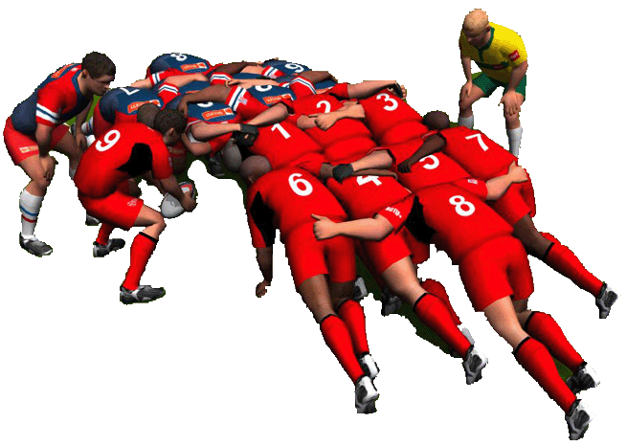
Scrum
Notes:
The word scrum comes from a rugby. A Scrum is used to restart play, as the forwards of each team interlock with their heads down and attempt to gain possession of the ball.

Slide 14

Scrum Artifacts
User Stories / Tasks
Describes the what more than the how of a customer-centric feature
Has a product-wide definition of done to prevent technical debt
Alternatively, could just define task of work to complete. A task is the smallest unit of deliverable that can be demonstrated.
Product Backlog
The product backlog comprises an ordered list of product requirements that a scrum team maintains for a product.
Sprint Backlog
The sprint backlog is the list of work the development team must address during the next sprint.
14
Notes:
Story:
Story exercise soon.
Sprint backlog:

Slide 15
Scrum Artifacts (cont.)
Product Increment (Sprint Deliverable)
All the work completed during a sprint.
At the end of a sprint, the increment must be complete, fully functioning, and in a usable condition.
15
Notes:
Story:
Story exercise soon.
Sprint backlog:

Slide 16
User Story
a user story is an informal, natural language description of one or more features of a software system. _{[3]}
Format
As a “role or user”,
I want “describe what the user wants”,
So that “describe why the user wants it”
Acceptance Criteria:
List of things that help define done
16

Slide 17
Ex: User Story
As a user, when viewing features on the evaluation form I want to only see references when desired,
So that only the important information is presented to me first, but I can discover more information when needed.
Acceptance criteria:
Users can expand to view reference details when provided for a given feature.
17
Notes:
Good because it tackles a discrete thing. Tells us why, and provides some idea of what done is.

Slide 18
Ex: Bad User Story
As a user I want the evaluation form to use a collapsible tree structure like on my iPhone menus to view references and allow me to click on a link to view references in another browser window.
Why this is a bad user story?
Dictates technology or method
Contains multiple deliverables (evaluation form structure, and linking to references.)
Does not explain the why.
What is done?
18
Notes:
Example User story

Slide 19
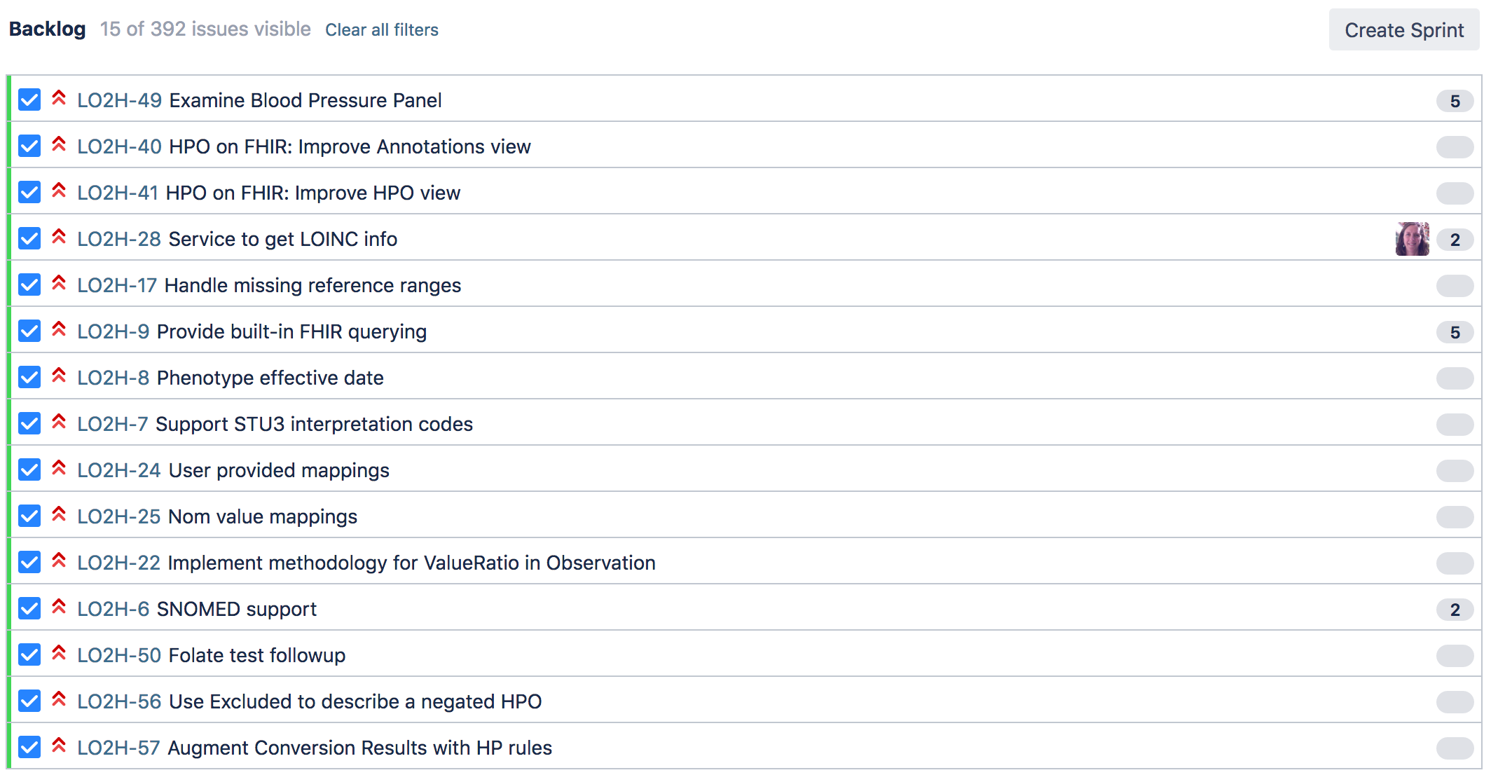
Ex: Scrum Backlog
19

Slide 20
Scrum Workflow
Sprint
A sprint (or iteration) is the basic unit of development in Scrum.
Scrum meeting (stand-up)
Each day during a sprint, the team holds a daily scrum
Sprint Planning
At the beginning of a sprint, the scrum team holds a sprint planning event
Mutually discuss and agree on the scope of work that is intended to be done during that sprint and select backlog items that can be completed during the sprint
Assign values to issues for how much work can be completed in sprint
20
Notes:
Sprint
The duration is fixed in advance for each sprint and is normally between one week and one month, with two weeks being the most common.^{[1]}
Each sprint starts with a sprint planning event that aims to define a sprint backlog, identify the work for the sprint, and make an estimated forecast for the sprint goal. Each sprint ends with a sprint review and sprint retrospective,^{[12]} that reviews progress to show to stakeholders and identify lessons and improvements for the next sprints.
Scrum emphasizes working product at the end of the sprint that is really done. In the case of software, this likely includes that the software has been fully integrated, tested and documented, and is potentially shippable.
Daily Scrum
Each day during a sprint, the team holds a daily scrum (or stand-up) with specific guidelines:
All members of the development team come prepared. The daily scrum:
starts precisely on time even if some development team members are missing
should happen at the same time and place every day
is limited (timeboxed) to fifteen minutes
Anyone is welcome, though only development team members should contribute.
During the daily scrum, each team member typically answers three questions:
What did I complete yesterday that contributed to the team meeting our sprint goal?
What do I plan to complete today to contribute to the team meeting our sprint goal?
Do I see any impediment that could prevent me or the team from meeting our sprint goal?
Any impediment (e.g., stumbling block, risk, issue, delayed dependency, assumption proved unfounded)^{[29]} identified in the daily scrum should be captured by the scrum master and displayed on the team's scrum board or on a shared risk board, with an agreed person designated to working toward a resolution (outside of the daily scrum). No detailed discussions should happen during the daily scrum.
Sprint Planning
- It is important to assign values using either hours estimates or story points (Fibonacci scale). This serves multiple purposes.
- verification that the team can complete all issues in sprint
- help understand velocity of the team (how much work is possible for good estimation. - one of the biggest risks in project development is not understanding how much effort is involved and missing deadlines.
- people who have vision and can make decisions on deliverables need to attend this meeting.

Slide 21
Scrum Workflow (cont.)
Sprint review
Takes place at the end of the sprint to demonstrate a working product increment to everyone who is interested, particularly stakeholders.
The meeting should feature a live demonstration, not a report.
This is the touch base opportunity in scrum/agile to make sure that project progress in in line with the goals of the project.
Sprint Retrospective
Each Sprint ends with a retrospective. At this meeting, the team reflects on its own process. They should take action to adapt for future Sprints.
Continuous improvement process build into scrum
21
Notes:
Sprint Review
The team and the stakeholders collaborate on what to work on next. Directly relates to the goals outlined in agile manifesto.
It is easier to make adjustments as development is happening incrementally, rather than wait till the end product does not work as expected.
Sprint Review
This meeting is for team introspection and improvement and should never be used to rank or determine how team / project is doing. That evaluation should be on the items delivered successfully.

Slide 22
SCRUM Sprint
Sprint planning meeting
DailyCycle
Sprint Planning
Product increment
Update product backlog
Sprint retrospective
Sprint review
RELEASE

Slide 23
Scrum Board
23

Slide 24
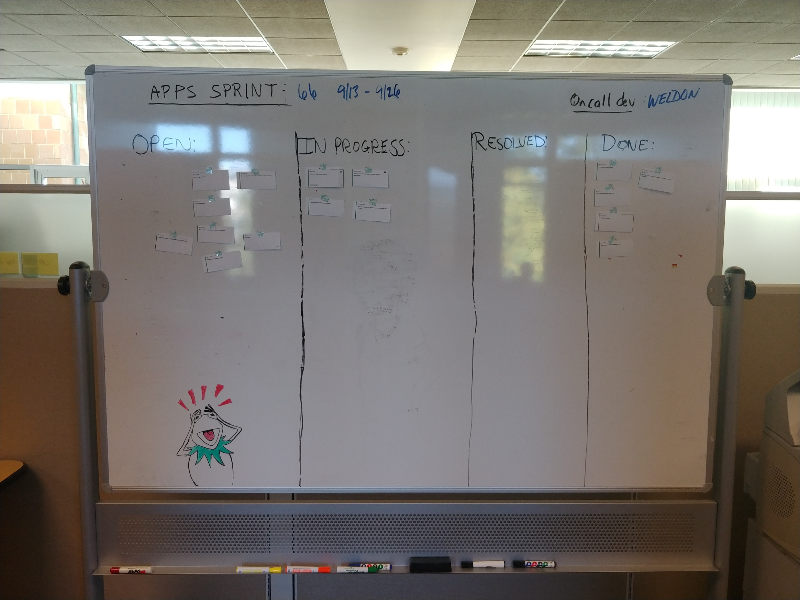
Scrum Board - analog
24

Slide 25
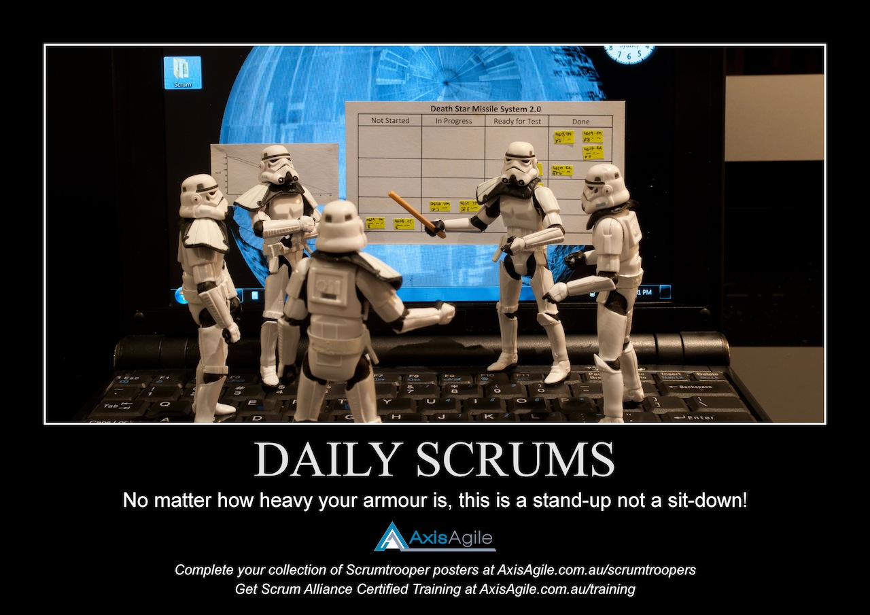
Scrum Board – Stormtroopers…
25

Slide 26
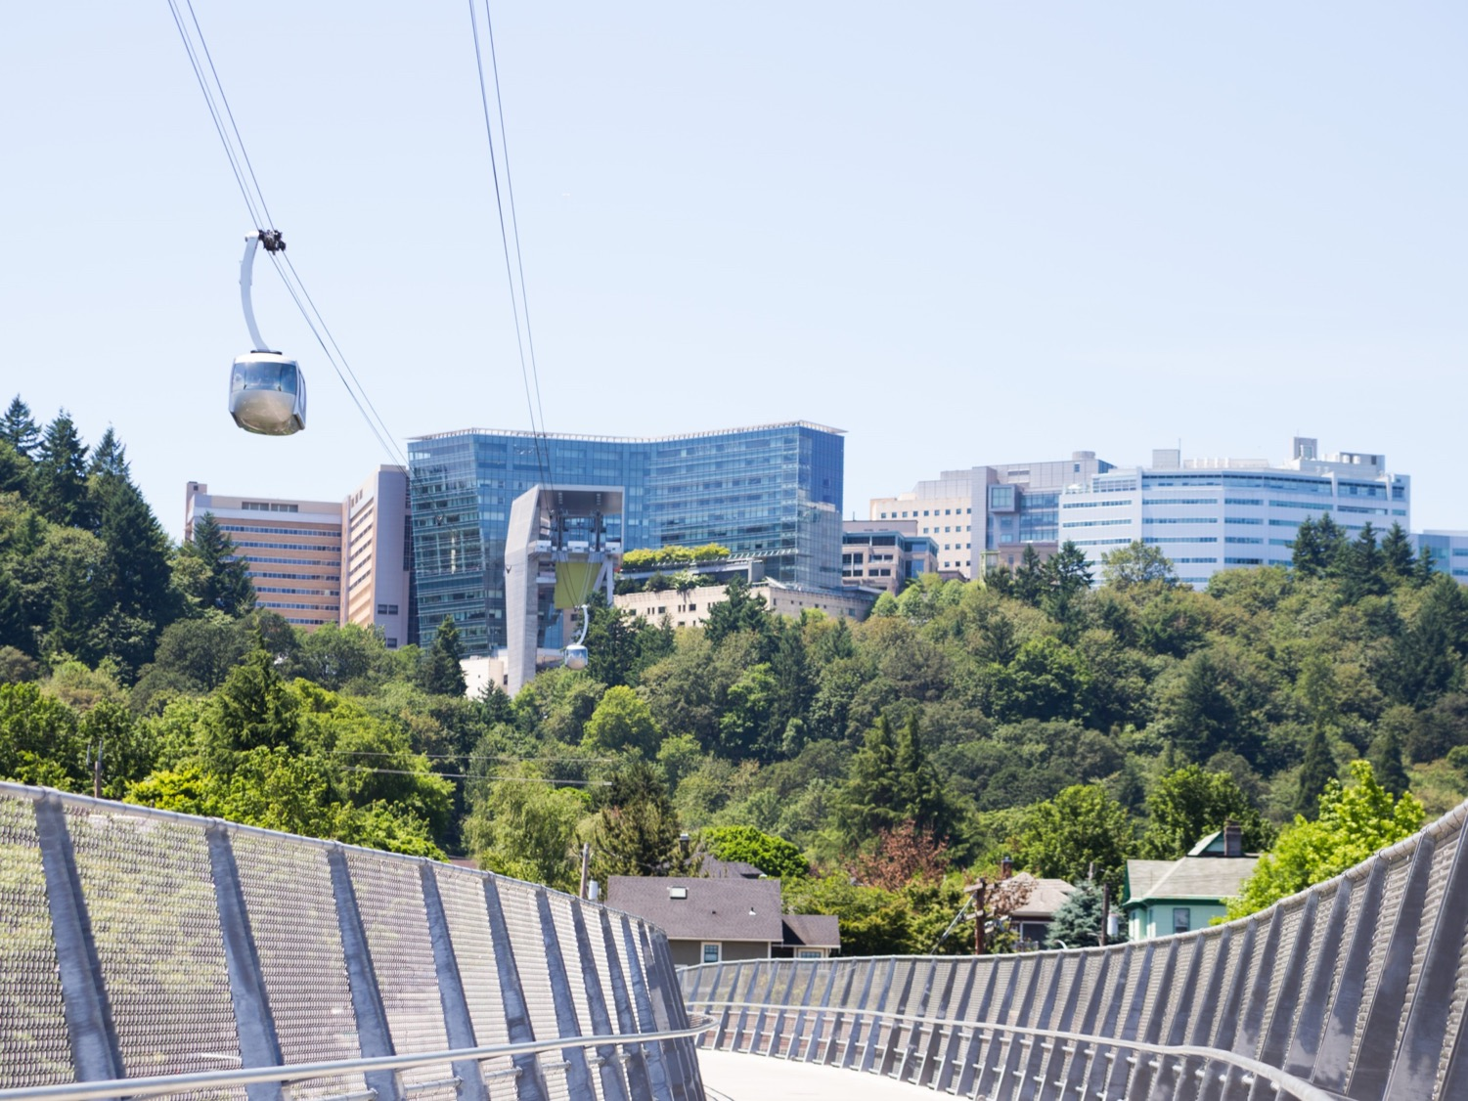
What does agile or scrum have to do with research?

Slide 27

Agile in research
Research IT projects are not always clearly defined.
Agile practices lend themselves well to the evolving nature of research development.
By focusing on minimum viable product, can deliver critical functionality first, then iterate improvements.
Research Agile Topics:
Best practices
Privacy and regulatory considerations
Security considerations
27

Slide 28

Research Project in Scrum
Sprint Iterations
Examples
Project Definition / Grant Writing
Writing the grant proposal
Budget estimates
Project definition
Sign-off
Project Funded / NOGA
Final budget planning
Scope of service
Project Kick-off
Planning
Sign-off
Analyst work
Development
Requirements / Documentation
Security reviews
Training
Execution / Development
Sign-off
Closure / Completion
Access to application
Data archiving
Documentation
28

Slide 29
Project Definition / Grant Writing
Project management really starts with research project inception and grant writing.
Incorporate technical solution into the research project definition and grant proposal.
Estimate the costs of technology for your research project.
Allows better planning and better chance for realizing the vision so that technology is not a roadblock to research or outcomes.
29

Slide 30
Planning
Grant / Research funded
Refine vision and plan to meet outcomes
Develop Project Charter (for technology solution)
The project charter helps define:
The goals of the project
Approach
Deadlines and expectations
Who will do what
Final cost
Could be internal or external to project team / OHSU
Sprint Backlog
Populate project backlog with team using the project charter as a guide.
30
Notes:
Story:
Story exercise soon.
Sprint backlog:

Slide 31
Project Execution
Project Kick-off
Sprint iterations
should be able to show working products based on the items in the sprint scrum.
Refine the backlog as part of the cycle, or re-evaluate and change aims and goals.
Refer back to charter to make sure that development does not drift, and project is in-line with original goals.
Original goals can be changed, but that change must be clearly understood and agreed to by stakeholders.
31

Slide 32
Security Considerations
HIPAA and patient privacy
PHI needs to be encrypted in transit and ideally at rest.
Secure sign-in for access to systems where appropriate.
Keeping up-to-date on security patches and updates for tech stack.
Patient consent needs to take into account where your data will live, and what data is collected.
IRB: Technology solution must be inline with Study protocol and IRB documentation.
Good news! These can be updated for a study.
Security Review: All systems at OHSU need to have a security review.
Internally developed research systems as well as contracted solutions and third party services.
If not done at beginning of study, can cause delays in research project.
https://o2.ohsu.edu/information-technology-group/help-desk/it-help-pages/security-review.cfm
32

Slide 33
Project Closure / Maintenance
How long does the project need to run?
Define roles for who will maintain users/access to solution
Plan for access to data after research project ends.
Extract data for analysis.
Shut down application or website and terminate access.
33
Notes:
Closure / Maintenance

Slide 34
Tools
Jira: https://www.atlassian.com/software/jira
GIThub: https://github.com/
Pivotal Tracker: https://www.pivotaltracker.com/
Sharepoint: https://products.office.com/en-us/sharepoint/collaboration
Confluence: https://www.atlassian.com/software/confluence
34

Slide 35

Questions??
35

Slide 36
^{References:}
[1] PMI.org Retrieved 14 September 2018.
[2] Mitchell, Ian (2016). Agile Development in Practice. Tamare House. p. 11. ISBN 978-1-908552-49-5.
[3] Wikipedia, 14 September 2018, https://en.wikipedia.org/wiki/User_story, Retrieved 14 September 2018
[4] agilemanifesto.org Retrieved 14 September 2018.

Slide 37

Thank You

